Slide 1
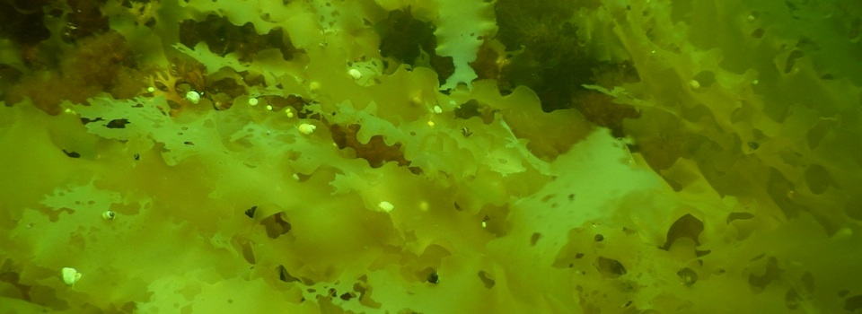
Changes in subtidal Gulf of Maine food webs in a shifting climate
Jarrett E.K. Byrnes
University of Massachusetts Boston

Slide 2
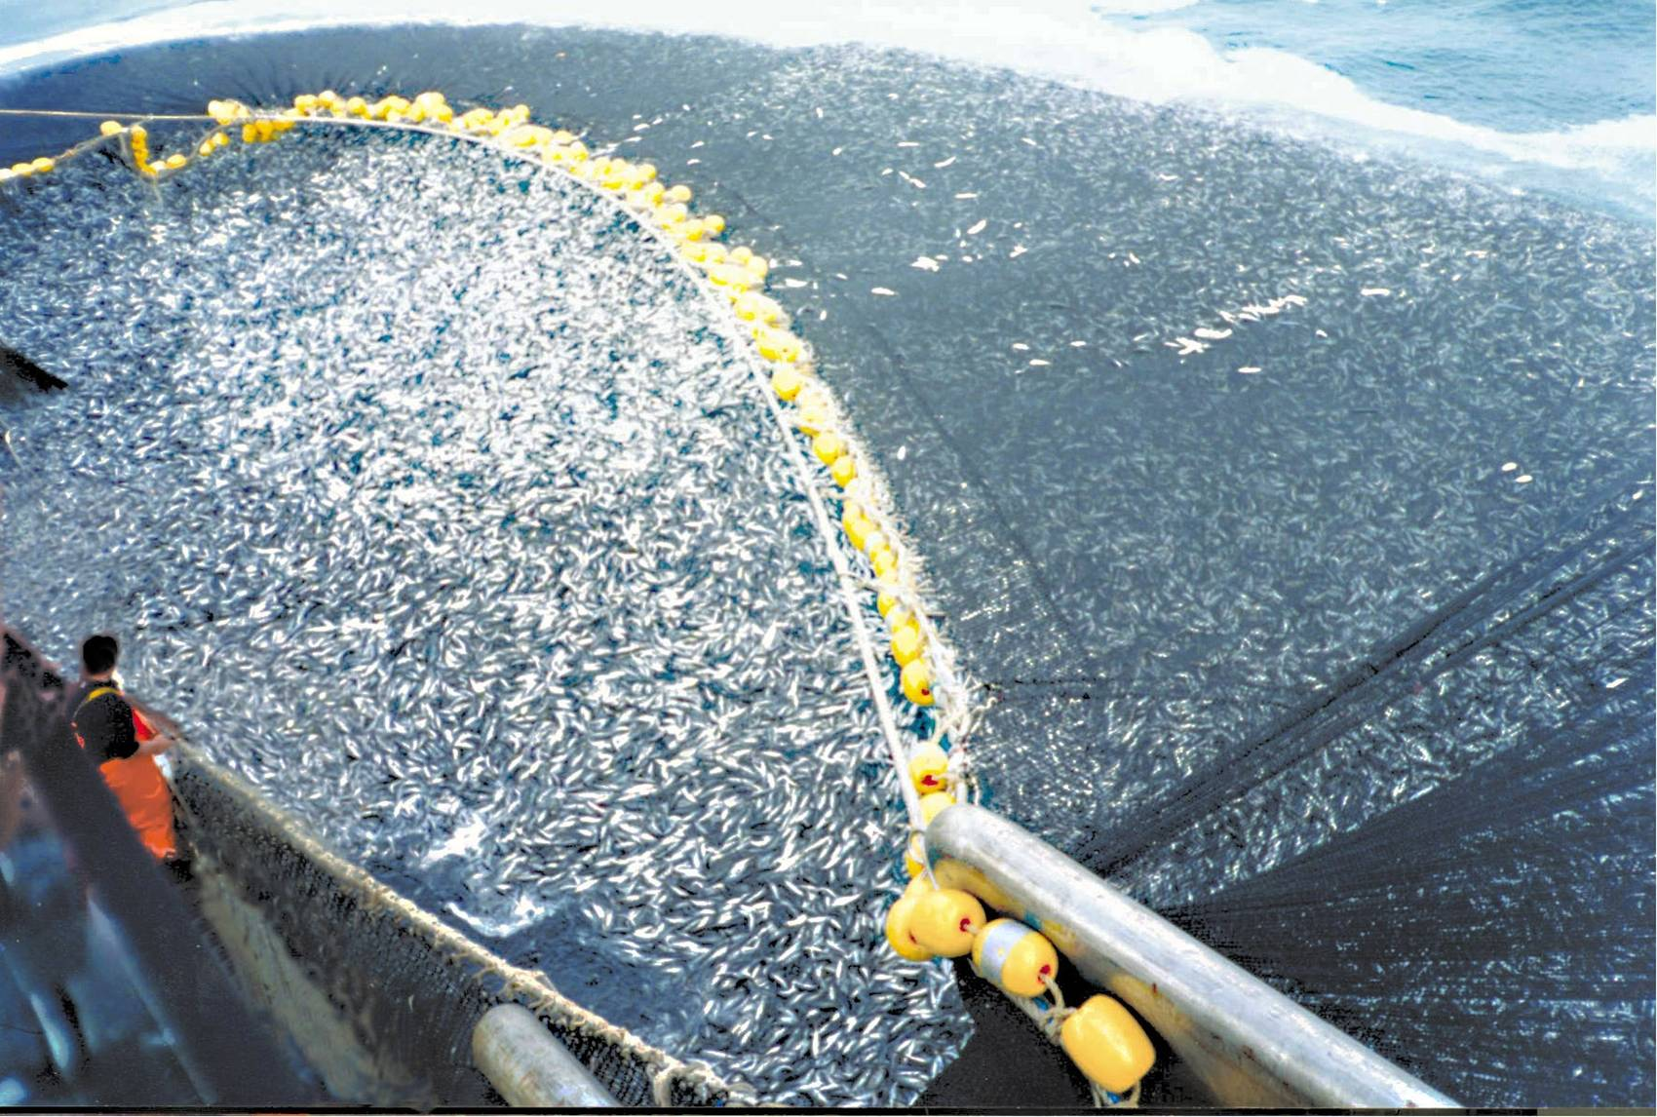
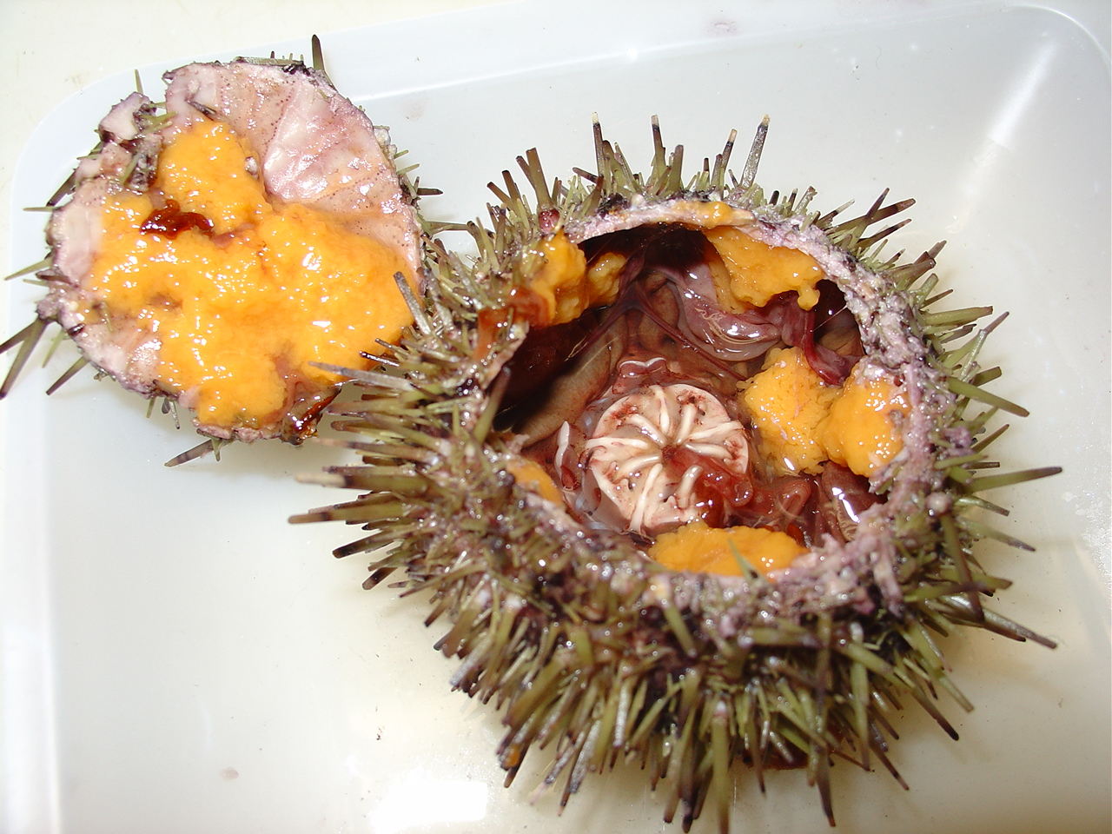
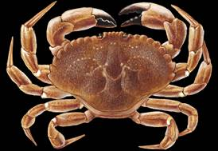
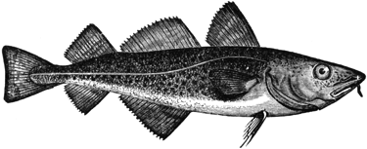
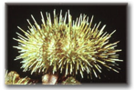

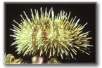
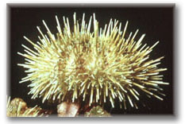
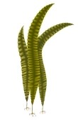
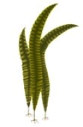
We Think A Lot About Fairly Linear Trophic Interactions in the Gulf of Maine…
GOM: Trophic Regime Shifts
1990-present
Pre-1970
Crabs
1970-1990

Slide 3
But Let’s Take a Step Back and Consider Whole Food Webs
Food web generated from ~1600 papers searched for 211 species
4,946 interactions identified between these and other species
21,958 interactions involving these species in the Global Biotic Interactions Database
Shown here is the 571 unique interactions between 97 species we can get reliable feeding relationships for
Effort from Caitlin DiCara, Nicole Gregg, Jillian Dunic, and the CIEE Living Data Project

Slide 4
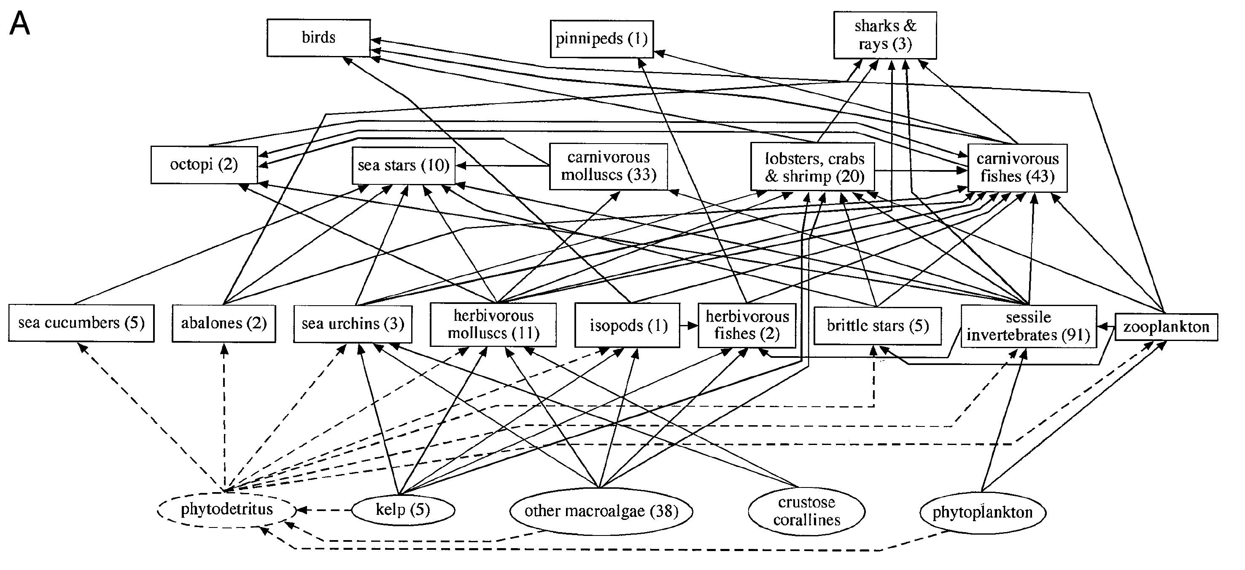
We Know Network Structure can Attenuate or Mask Phenomena like Trophic Cascades
x
Alaska/Aleutians
x
Southern
California
Otter
Otter
Sea Lions
King Crabs
Fish
Sea Stars
Predatory Crabs
Mollusks
Urchin
Kelp Crabs
Other Macroalgae
Kelp
Modified from Graham 2004 Ecosystems
See also Polis and Strong 1996, and work from K. Wootton, Stouffer, and others…

Slide 5
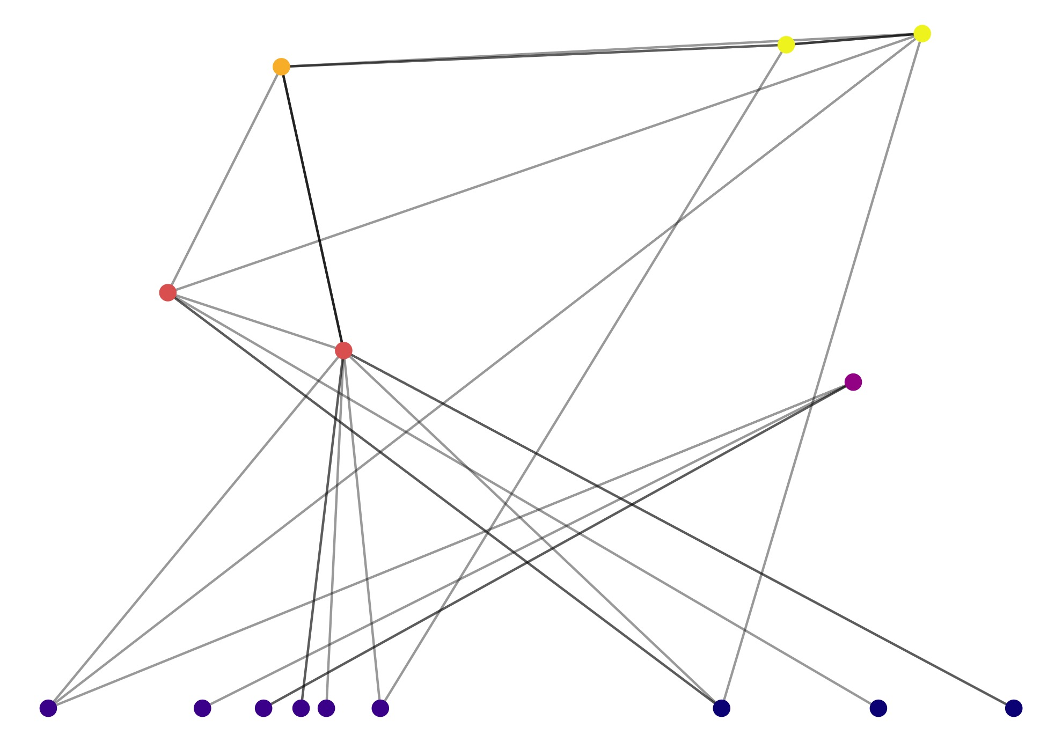
Why is Thinking about Food Whole Food Web Networks Important?
Propensity towards Trophic Cascades
Resilience and Stability
Efficiency of Trophic Transfer
Insights for conservation planning
Little Brewster 2017

Slide 6
What Might we Predict about Ocean Warming and Network Structure?
Gain in Warm Water Species
Gain in Generalists
Overall Species Loss
Loss of Specialists
See Albouy et al. 2014, Kortsch et al 2015, Dunic et al. 2017 for Discussions
Notes:
Dunic et al 2017 – loss over time (although shortterm gain)
Albouy et al 2014 – increase in connectace due to differential sp loss and survival of generalists (increase in generality and vulnerability)
Increase in SR from lower latitudes – but, temporal scale? And selectivity of who
Kortsch et al 2015 boreal fw gain generalists and lose specialists

Slide 7
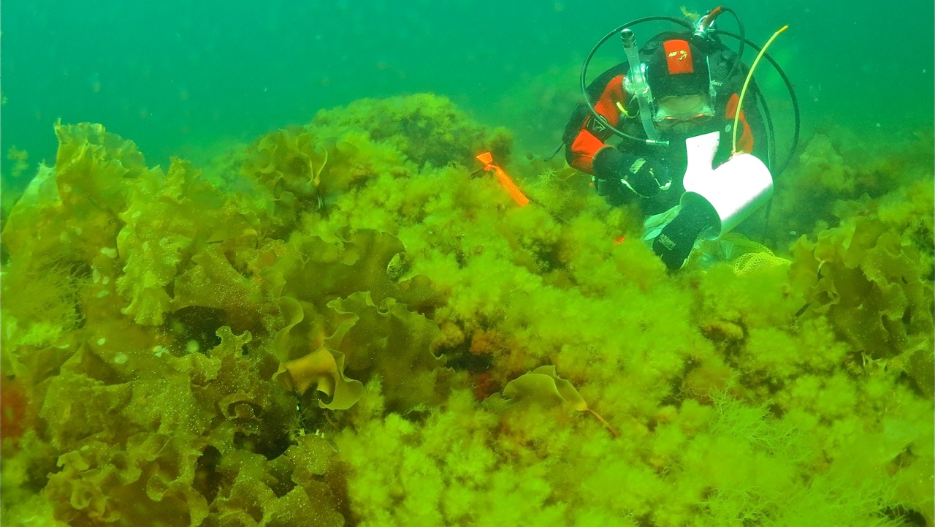
How Will New England Kelp Forest Food Web Structure Change with Warming Waters?
R. Scheibling

Slide 8
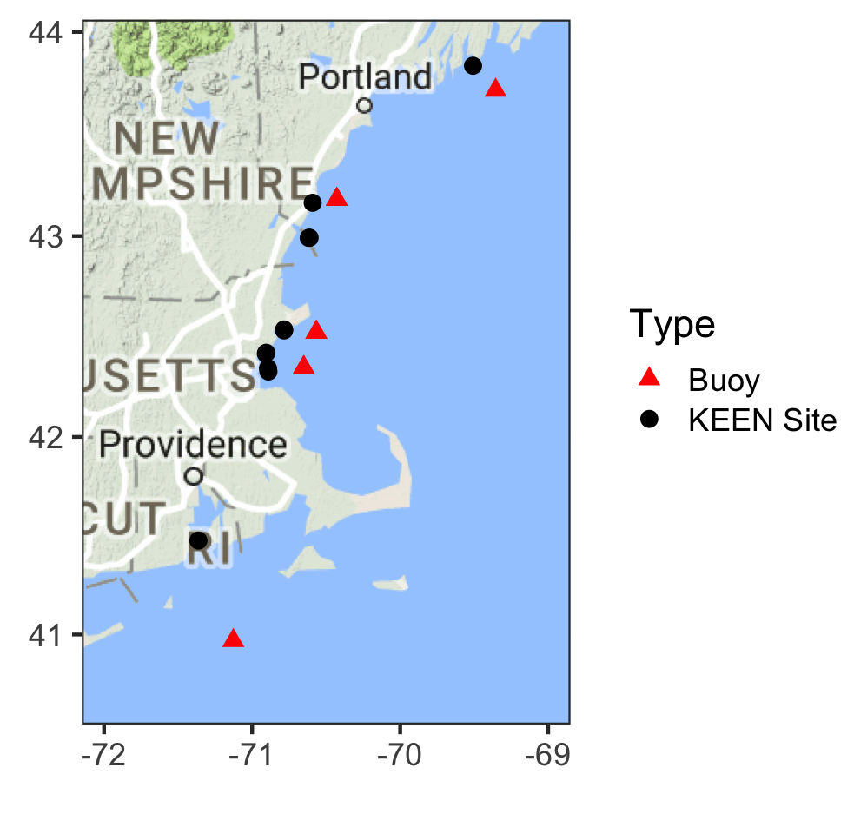
Surveys from 2014-2018 to Evaluate the Impact of Temperature Change
Kelp Ecosystem Ecology Network Of New England
Consortium of UMass Boston, Northeastern University, Salem State University, Bigelow Labs, University of New Hampshire, University of Maine, University of Rhode Island, Southern Connecticut State College, Adelphi University
Notes:
Since 2013, we’ve been sampling sites from Rhode Island to downeast Maine. This is wonderful, as these sites sit along a gradient of temperature, and, because we’ve been sampling them over time, we also have records of fluctuations in temperature from year to year. Because of this, we’ve been able to do some cool data analysis using tools from economics, actually, to cleanly tease out the signal of temperature.

Slide 9
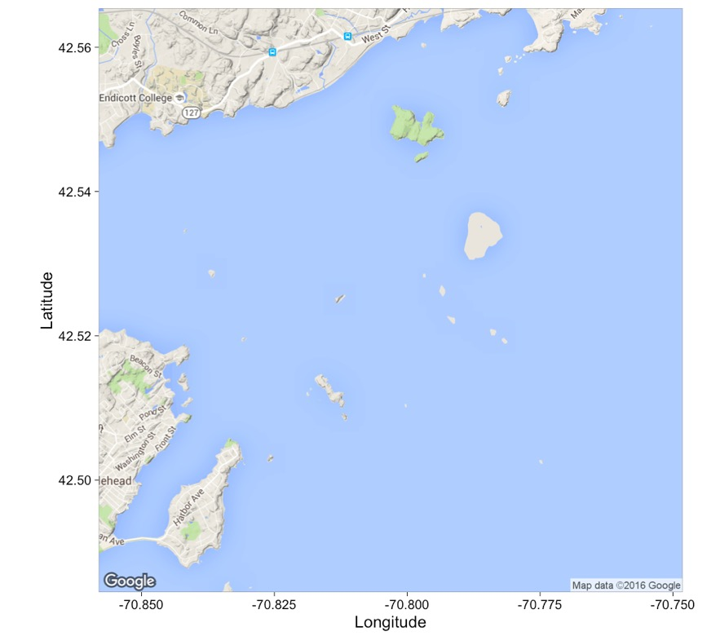
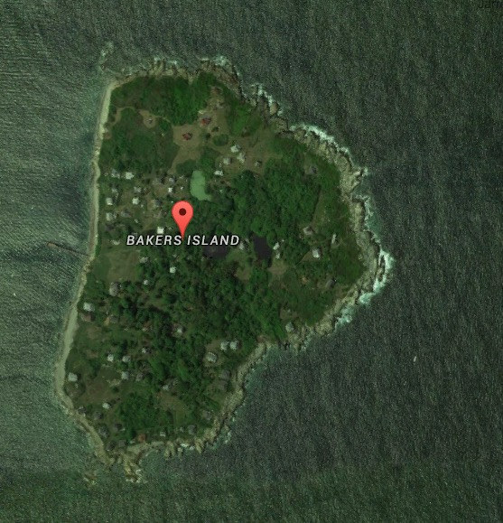

KEEN Sites: Four Stratified Random Transects Sampled Annually
Long-Term Observations
Halftide Rocks
Misery
House
Bakers
Eagle
The Gooseberries
Dry Breakers
Children’s
Satan Rock
Halfway Rock
Notes:
At each site we sample four transects per year – so, here are two sites we have around Bakers island in Salem Sound.

Slide 10
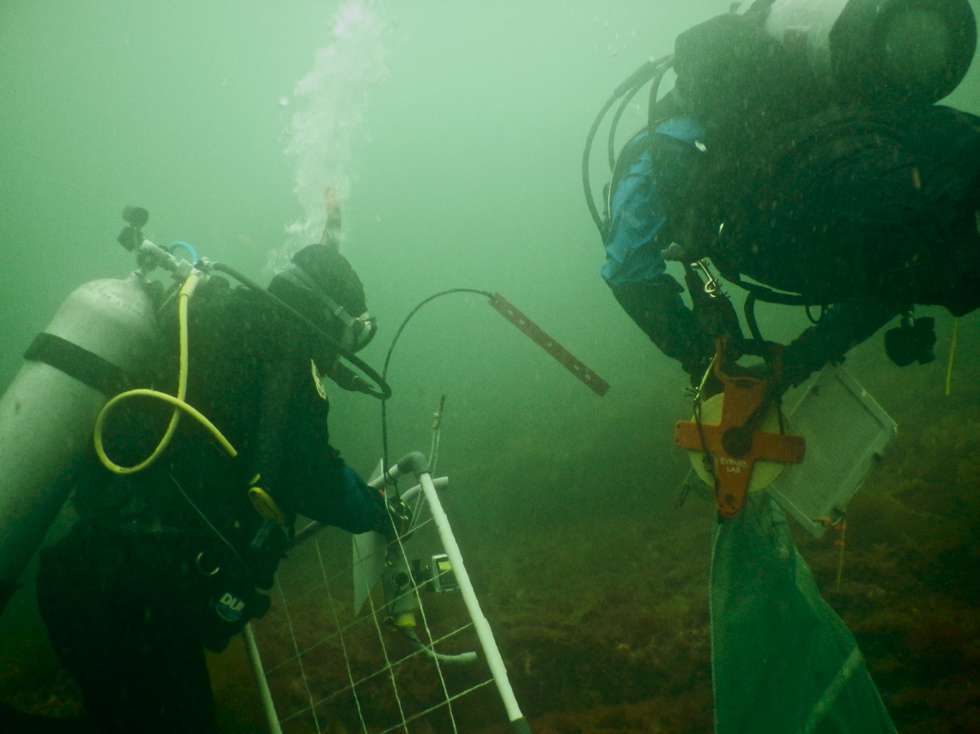
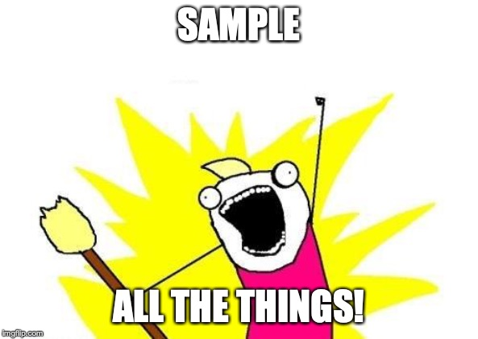
Abundances of 215 Species assessed via:
80m² Fish Transects
6 1m² Quadrat Counts
4 20m² Swath Counts
80 Uniform Benthic Point Counts
Notes:
Along sites, we perform a wide variety of sampling techniques to quantify kelp cover and the diversity and abundance of over 150 animals and algae.

Slide 11
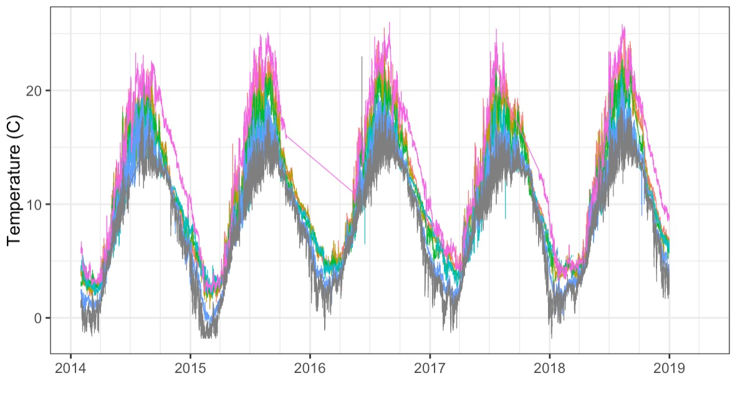
Buoys Show Great Variability in Temperature in Space and Time

Slide 12
Digging Out a Temperature Signal Using Econometric Causal Inference Techniques
Temperature
Network Metric

Slide 13
Digging Out a Temperature Signal Using Econometric Causal Inference Techniques
Site Mean
Temperature
Site
Site:Year
Temperature Anomaly
Network Metric
Richness
Error
Kelp Abundance

Slide 14
Can Warming Have Direct and Indirect Effects on Food Webs?
Winter Temperature
Anomaly
Species
Richness
Network
Metrics
Kelp
Summer Temperature
Anomaly

Slide 15
Network Metrics to Describe Food Web Shape
Connectance: Average probability two species are connected
Diameter: Shortest distance from basal species to top predator
Average Degree: Average consumer diet breadth
SD Degree: Variation in consumer diet breadth

Slide 16
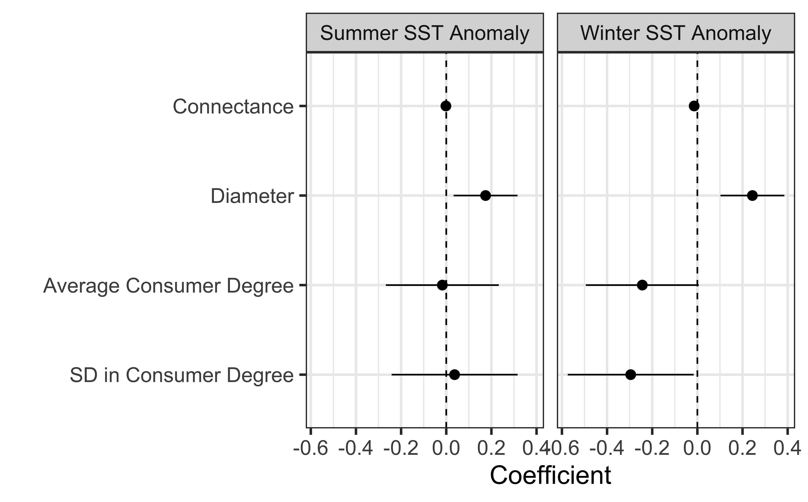
Winter Temperatures Drive Linearity in Food Webs
Warming leads to less connected web
Shortest path length from resource to top predator is longer
BUT – Consumers have fewer prey on average
Consumers are more similar in the number of prey per species

Slide 17
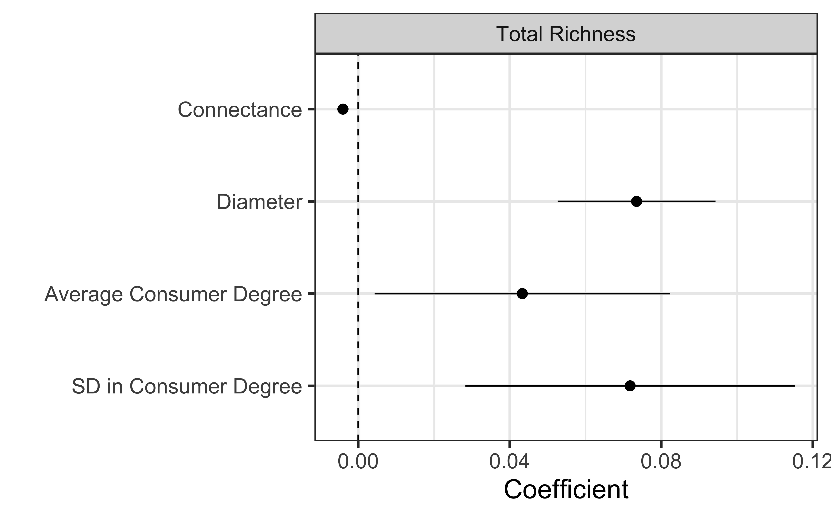
Richer Webs Have More Variety – Less Connected, but More Generalist Species and More Variation

Slide 18
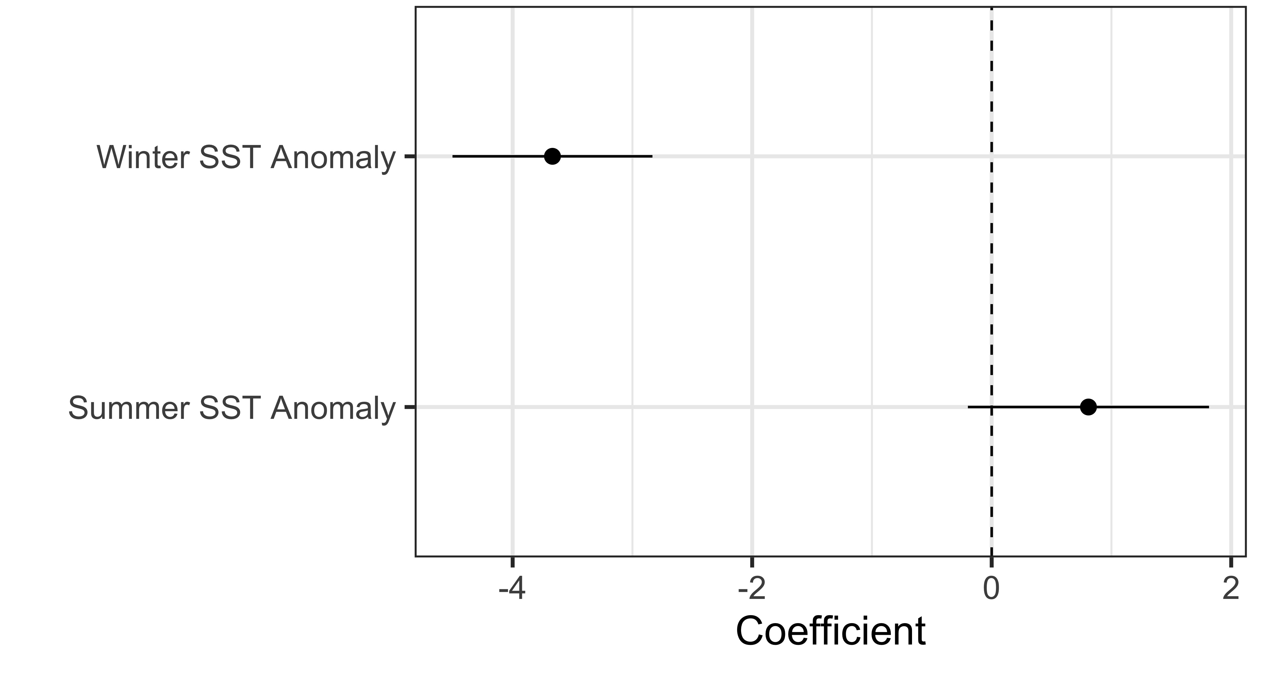
Warmer Waters Lead to Lower Species Richness – This Enhances Linearizing of Food Webs
n.b. No kelp effects…

Slide 19
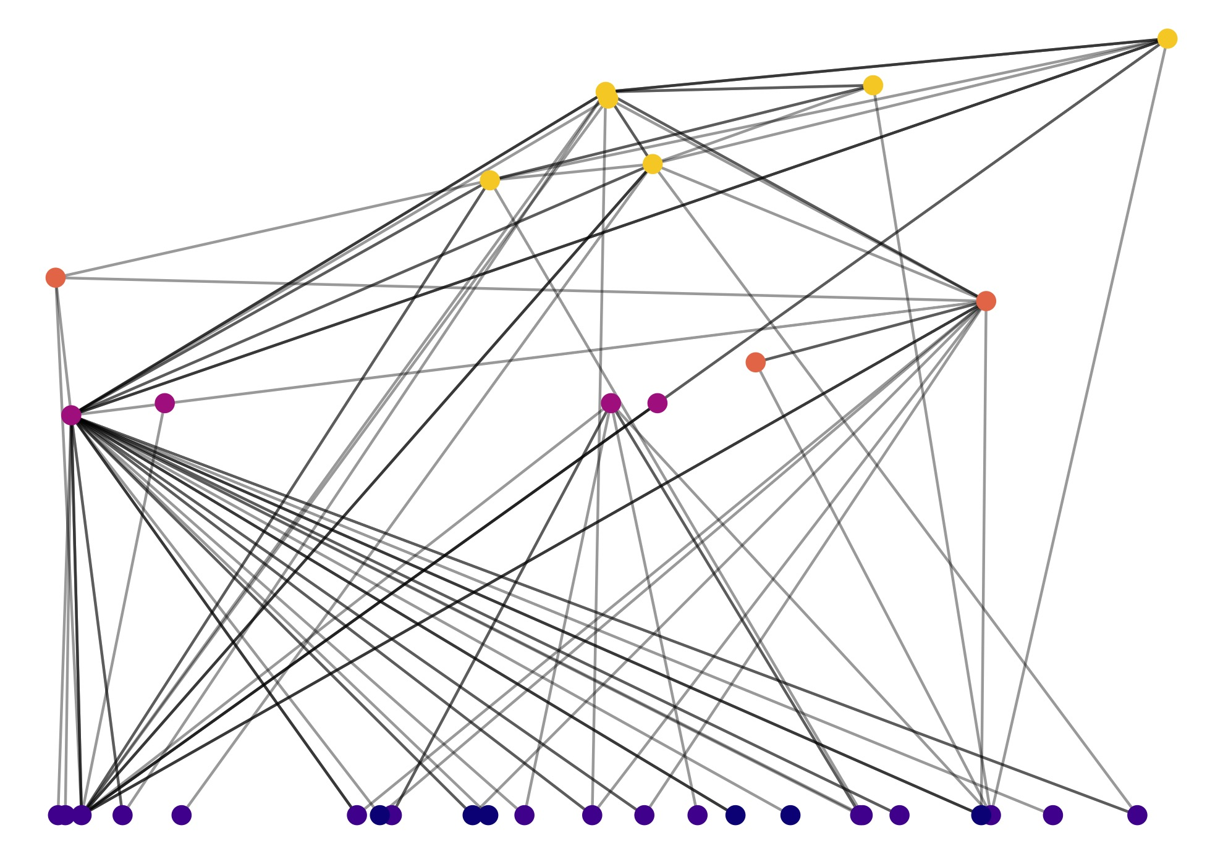
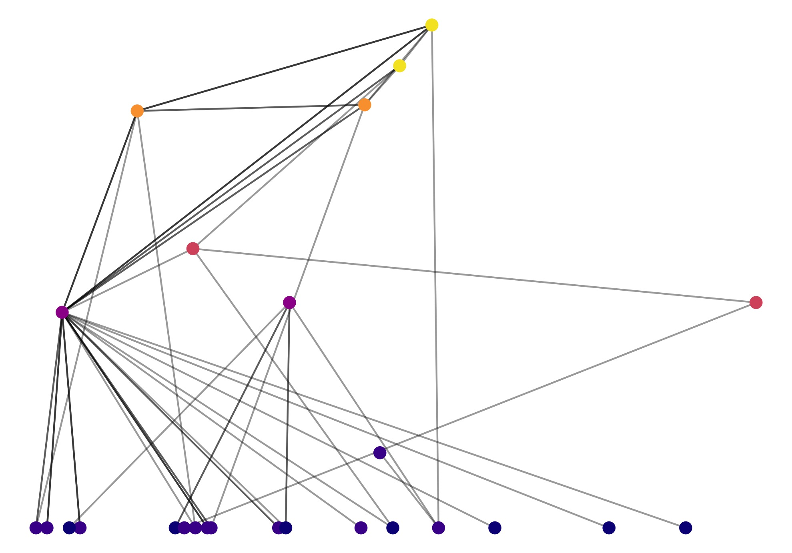
Compare Cool versus Warm Year on Appledore Island
2014: -1℃ Anomaly
2018: +0.6℃ Anomaly
Notes:
Top: Crabs, sculpins, cunner – versus mostly crabs, some juvie urchins holding it together and henricia

Slide 20
Warming Generates More Depauperate Webs With More Chains
Species Loss
Less Connectance
Longer Food Chains
Less Generalized species
See Albouy et al. 2014, Kortsch et al 2015, Dunic et al. 2017 for Discussions
Notes:
Dunic et al 2017 – loss over time (although shortterm gain)
Albouy et al 2014 – increase in connectace due to differential sp loss and survival of generalists (increase in generality and vulnerability)
Increase in SR from lower latitudes – but, temporal scale? And selectivity of who
Kortsch et al 2015 boreal fw gain generalists and lose specialists

Slide 21
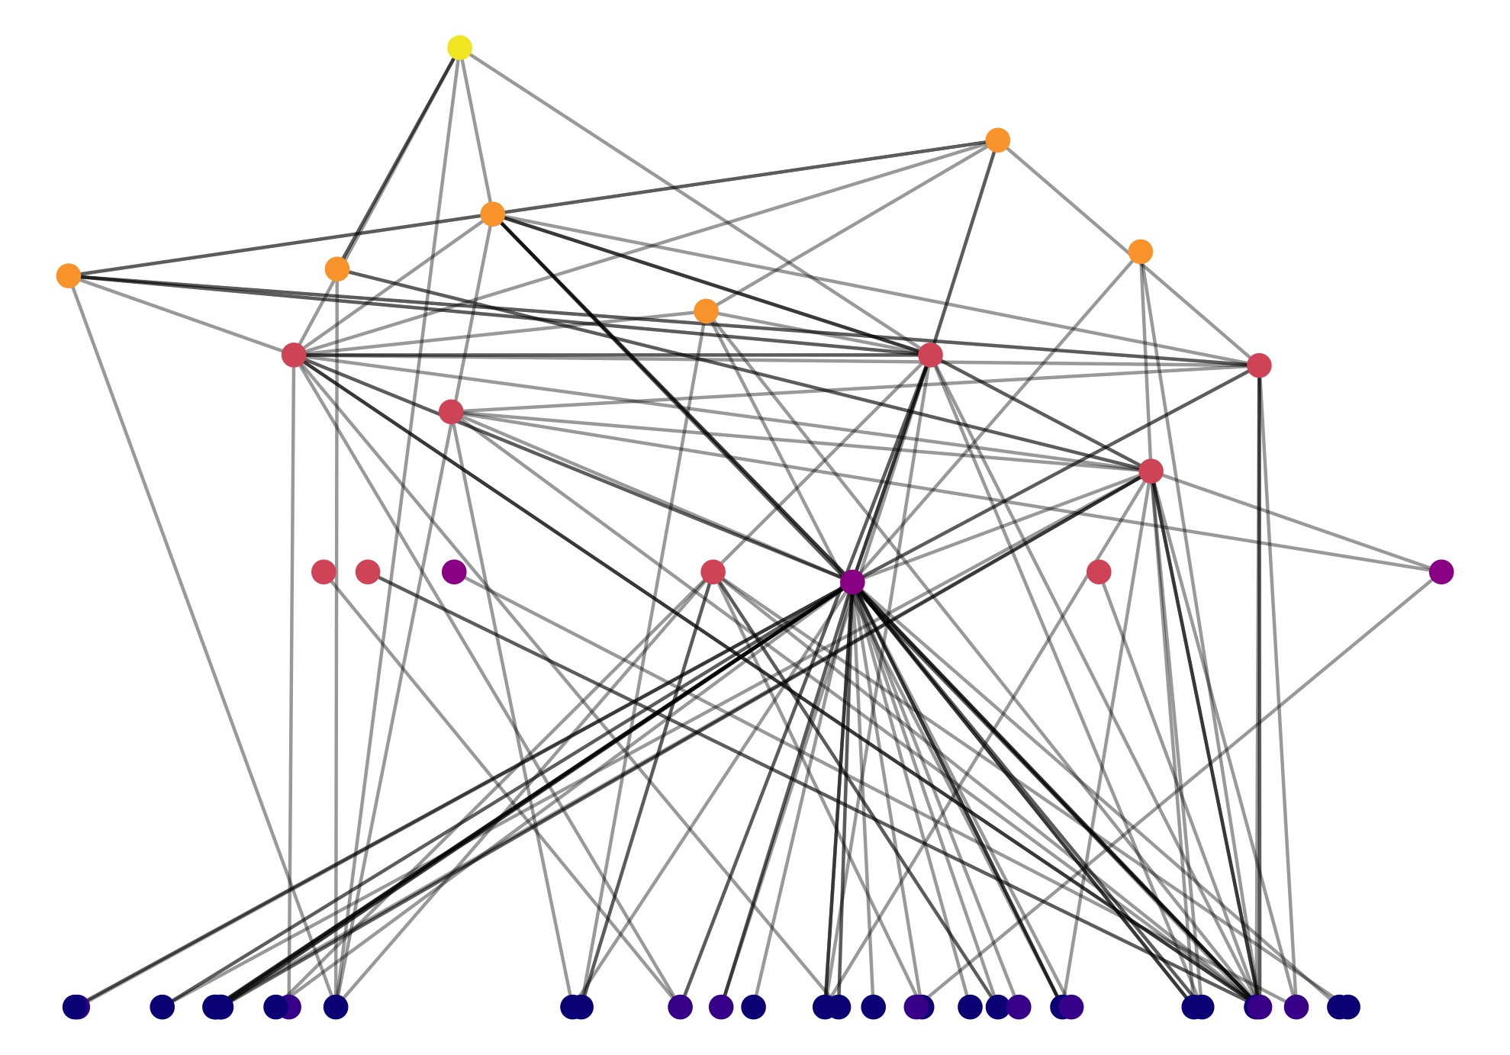
A Warming Gulf of Maine Could Lead to Simpler Less Resilient Food Webs
Warming waters directly affect food web structure within sites over time
Webs lose species and become more linearized
This could lead to future instability and lack of resilience to other environmental disturbances
BUT – we did not see any range expansions/species turnover in the time-span of this study in *our* observations
Northeast Appledore

Slide 22
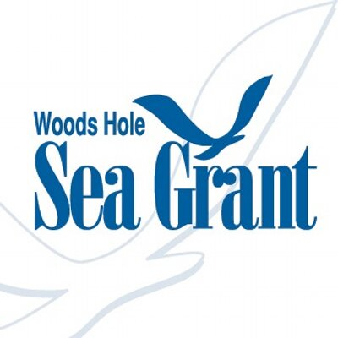
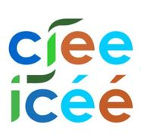


Thanks!
Food Web Champions: Caitlin DiCara, Nicole Greg, Jillian Dunic, Breckie McCollum
CIEE/LDP Group Members: Julien Beaulieu, Andrea Brown, Amelia Hesketh, Nicole Knight, Jake Lawlor, Jenny Muñoz Zapata, Tianna Peller, Alexis Pereira, Kate Sheridan, Laura Super, Ellen Bledsoe, Joey Burant
KEEN ONE: Jennifer Dijkstra, Jon Grabowski, Doug Rasher, Austin Humphries, Melissa MacMahan, Caitlin Cleaver, and So Many Divers…

Slide 23
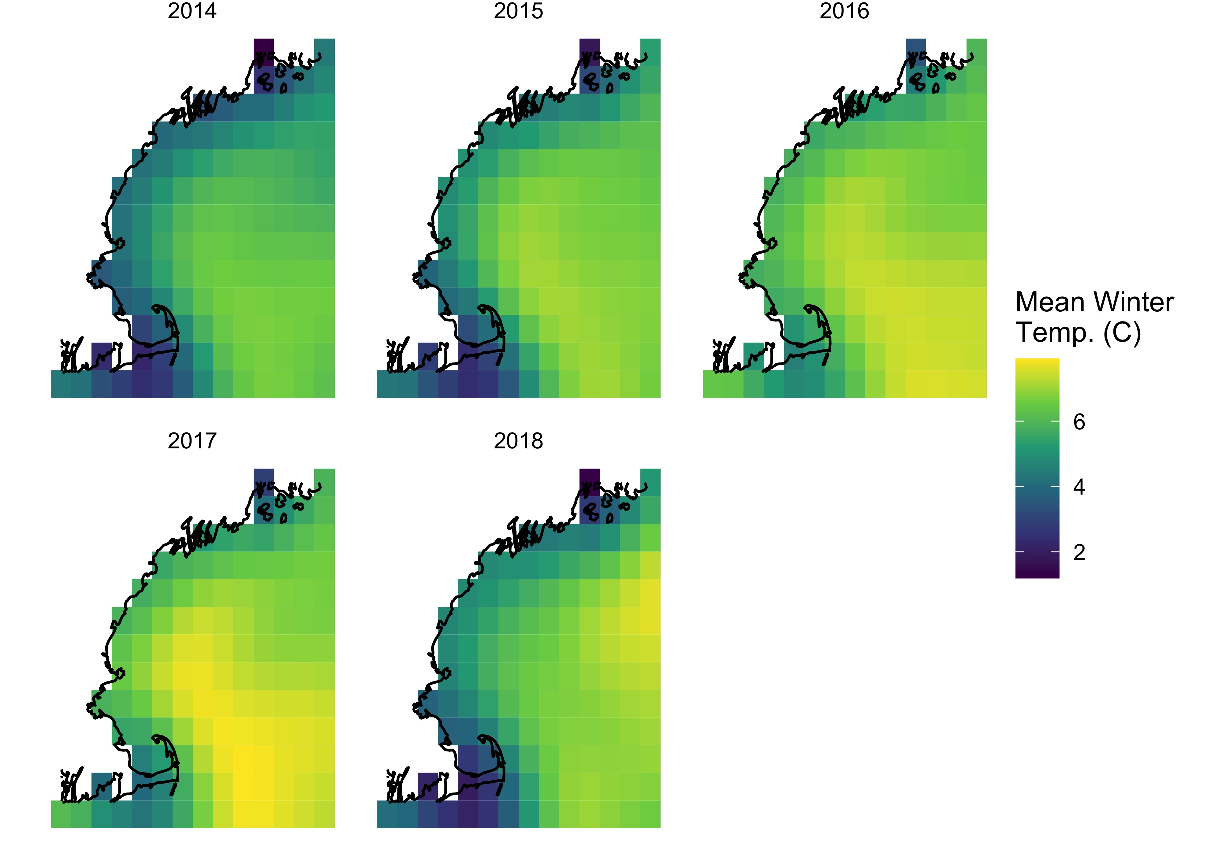
A Trend in Water Temp Over Time
NOAA OISST

